Slide 1


A
Mini Project – II Presentation
on
Presentation
CYBERGUARD
An Immersive Cybersecurity Simulation Platform
Department of Computer Engineering
School of Engineering & Technology
D.Y. Patil University, Pune.
Academic Year 2023-24.
Red-Team
Blue-Team

Slide 2
Team Members
Vasu Tyagi (B-93)
Akash Sundararaju (B-94)
Siddharth Nair (B-81)
Aditya Khera (B-82)

Slide 3
Index
Introduction
Literature Survey
Flowchart
Schematic
Methodology
Real World Predicaments
Our Resolutions
Why CyberGuard
Hurdles
Applications

Slide 4
Index
AI Assistant
Analysis
Simulation Results
Final look
Conclusions
QnA
Contribution
References

Slide 5
Introduction
In response to the growing importance of cybersecurity, our college project, "CyberGuard," is a cutting-edge initiative aimed at creating an immersive cybersecurity training platform. With a focus on realistic simulations, user feedback, and continuous improvement, we strive to empower individuals and organizations to navigate the complex world of cyber threats with confidence.
01/36

Slide 6
Literature Survey
S. N. | Name of Author | Title | Publication | Methodology | Drawbacks
1. | Kara, S. Hizal, S. Zengin, A. | Design and Implementation of a DEVS-Based Cyber-Attack Simulator for Cyber Security | International Journal of Simulation Modelling | Network Architecture and DEVS-Suite Environment Modelling the Attacks Simulated Attack Types and Methods Conclusion and Future Work | Limited Types of Attacks Authenticity of Test Results Scalability Lack of Real-Time Analysis Dependence on DEVS-Suite
2 | Hamdi Kavak Jose J. Padilla Daniele Vernon-Bido Saikou Y. Diallo Ross Gore Sachin Shetty | Simulation for cybersecurity: state of the art and future directions | Journal of Cybersecurity | Literature Review Identification of Research Areas Characterization of Cybersecurity Proposal for Future Research | No clear classification Doesn't cover all the important topics Does not discuss ethical and moral implications No comprehensive review provided
02/36

Slide 7
Literature Survey
S. N. | Name of Author | Title | Publication | Methodology | Drawbacks
1. | Song-Yi Hwang Jeong-Nyeo Kim | A Malware Distribution Simulator for the Verification of Network Threat Prevention Tools | Sensors 2021, 21(21) | The paper presents a malware simulation tool for IoT infrastructure. The tool modifies the Mirai botnet malware. It uses a device-to-device command injection method for infecting IoT devices with private IP addresses. | Accuracy: The simulation tool might not perfectly mimic real-world. Scalability: The tool might face challenges when used to simulate large-scale networks. Adaptability: The tool might not be able to quickly adapt.
2 | David Harley Lysa Myers Eddy Willems | Test Files and Product Evaluation: the Case for and against Malware Simulation | AVAR (Association of Anti-Virus Asia Researchers 13th Conference, November 2010 | Proposes a new. Modifies the EICAR test. Tests the modified files on 12 different antivirus products. Measures the detection rates of these products. Analyzes the. | EICAR test file only tests pattern-matching signatures. Test file can be exploited for malicious purposes. Not all virus scanners are compliant and may not detect the file.
03/36

Slide 8
Literature Survey
S. N. | Name of Author | Title | Publication | Methodology | Drawbacks
1. | Jack Holdsworth Edward Apeh | An Effective Immersive Cyber Security Awareness Learning Platform for Businesses in the Hospitality Sector | IEEE | Create an immersive cyber security awareness learning platform. 40 interviews and threat analysis to elicit the industry requirements and challenges. Evaluates impact | Human factor Effectiveness Scalability Constant changes
2 | Nestoras Chouliaras George Kittes Ioanna Kantzavelou Leandros Maglaras Grammati Pantziou Mohamed Amine Ferrag | Cyber Ranges and TestBeds for Education, Training, and Research | MDPI Applied Sciences | Literature Review Identification of Research Areas Characterization of Cybersecurity Proposal for Future Research | No clear classification Doesn't cover all the important topics Does not discuss ethical and moral implications No comprehensive review provided
04/36

Slide 9
Literature Survey
S. N. | Name of Author | Title | Publication | Methodology | Drawbacks
1. | Mohd Hafiz Daud M. R. K. Chaminda Wijesooriya Wan Mohd Norsani Wan Nik Muhammad Muhsin C. W. M. N. Wijesooriya Rui Galhano | Immersive and Non-Immersive Simulators for the Education and Training in Maritime Domain—A Review | MDPI Applied Sciences | Network Architecture and DEVS-Suite Environment Modelling the Attacks Simulated Attack Types and Methods Conclusion and Future Work | Limited Types of Attacks Authenticity of Test Results Scalability Lack of Real-Time Analysis Dependence on DEVS-Suite
2 | Michael D. Workman | Journal of Cybersecurity Education, Research and Practice | Jones & Bartlett Publishers | Proposes a new. Modifies the EICAR test. Tests the modified files on 12 different antivirus products. Measures the detection rates of these products. Analyzes the. | EICAR test file only tests pattern-matching signatures. Test file can be exploited for malicious purposes. Not all virus scanners are compliant and may not detect the file.
05/36

Slide 10
Literature Survey
S. N. | Name of Author | Title | Publication | Methodology | Drawbacks
1. | Aws Jaber Lothar Fritsch | Towards AI-powered Cybersecurity Attack Modeling with Simulation Tools: Review of Attack Simulators | SpringerLink | Literature Review Identification of Research Areas Characterization of Cybersecurity Proposal for Future Research | Limited Types of Attacks Authenticity of Test Results Scalability Lack of Real-Time Analysis Dependence on DEVS-Suite
2 | Vladislav D. Veksler Norbou Buchler Blaine E. Hoffman Daniel N. Cassenti Char Sample Shridat Sugrim | Simulations in Cyber-Security: A Review of Cognitive Modeling of Network Attackers, Defenders, and Users | Frontiers | Network Architecture and DEVS-Suite Environment Modelling the Attacks Simulated Attack Types and Methods Conclusion and Future Work | No clear classification Doesn't cover all the important topics Does not discuss ethical and moral implications No comprehensive review provided
06/36

Slide 11
Literature Survey
S. N. | Name of Author | Title | Publication | Methodology | Drawbacks
1. | Cloudshare | Cybersecurity simulation training: a definition | Cloudshare | Network Architecture and DEVS-Suite Environment Modelling the Attacks Simulated Attack Types and Methods Conclusion and Future Work | Limited Types of Attacks Authenticity of Test Results Scalability Lack of Real-Time Analysis Dependence on DEVS-Suite
07/36

Slide 12
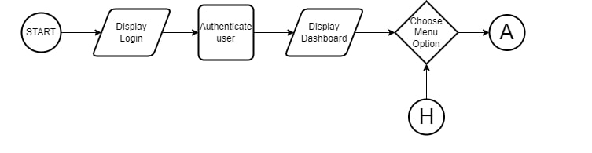
Flowchart
08/36

Slide 13
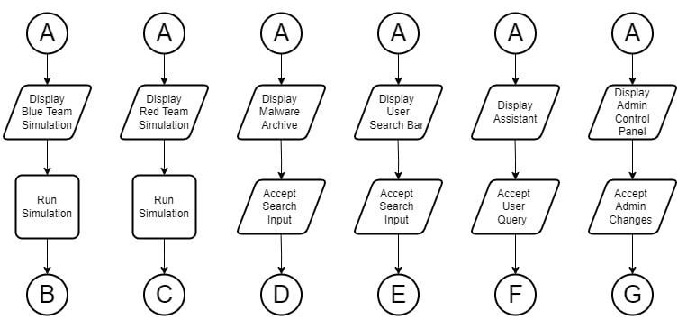
Flowchart
09/36

Slide 14
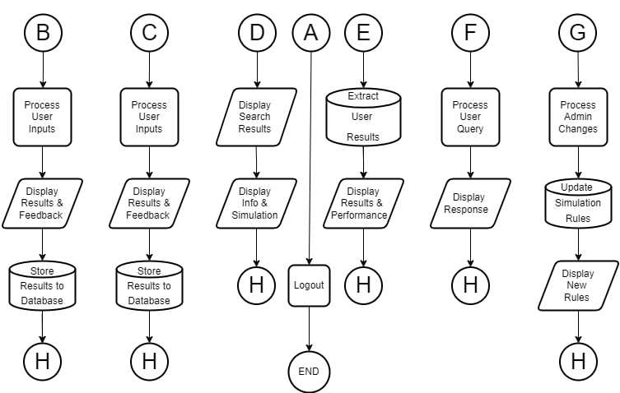
Flowchart
10/36

Slide 15
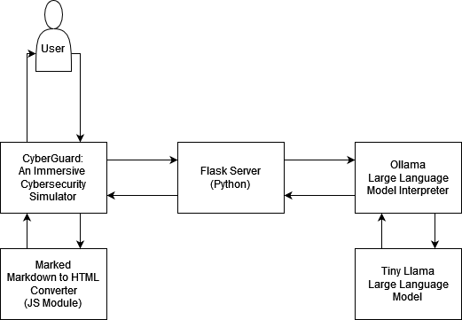
Flowchart
11/36

Slide 16
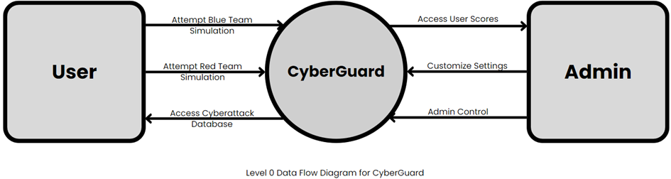
Schematic
12/36

Slide 17
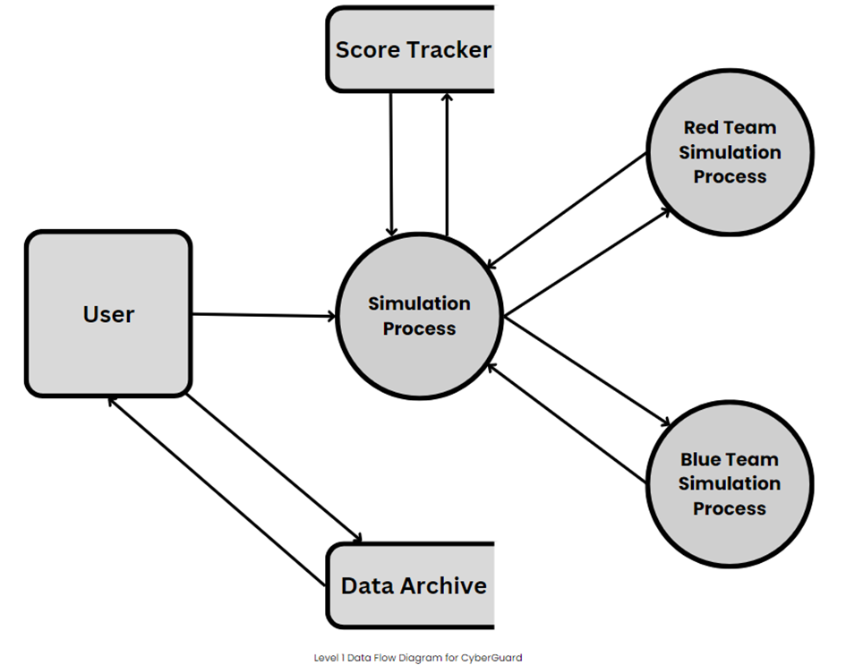
Schematic
13/36

Slide 18
Methodology
01
02
03
Project Initiation and Vision
Prototype and User Feedback
Iterative Development
Define project objectives, target audience, and create a comprehensive plan.
Develop an initial prototype and gather user feedback.
Enhance specific aspects of CyberGuard in each iteration.
14/36

Slide 19
Methodology
04
05
06
Continuous Integration and Security
User Engagement and Compliance
Documentation and Releases
Implement automated testing, security measures, and stay updated with cybersecurity trends.
Maintain open communication, gather feedback, and ensure compliance.
Provide comprehensive documentation, share cybersecurity knowledge, and release updated versions securely.
15/36

Slide 20


Real World Predicaments
01
02
03
Hands-on Blue Team experience.
Hands-on Red Team experience.
Thorough archive of malware.
Scarce practical Blue Team training opportunities.
Limited access to Red Team simulation.
Inadequate malware database availability.
16/36

Slide 21


Our Resolutions
01
02
03
Hands-on Blue Team experience.
Hands-on Red Team experience.
Thorough archive of malware.
CyberGuard provides practical Blue Team training opportunities.
CyberGuard offers accessible Red Team simulation.
CyberGuard provides an extensive malware database for research and analysis.
17/36

Slide 22
Why CyberGuard?
Hands-On Learning
Enables realistic, hands-on cybersecurity practice for skill enhancement.
Realistic Threat Scenarios
Prepares users with a diverse library of real-world threat scenarios.
Immediate Feedback
Facilitates rapid learning through instant user action feedback.
18/36

Slide 23
Why CyberGuard?
Customization & Gamification
Tailors scenarios and gamifies learning for heightened engagement.
Safe & Current
Ensures secure practice and stays updated with evolving cyber threats.
19/36

Slide 24
Limited Realism
Hurdles
In the future, we’ll focus on refining our simulation scenarios for greater realism, implementing user-friendly features to ease the learning curve, and striking a balanced approach between gamification and comprehensive cybersecurity knowledge.
Steep Learning Curve
Overemphasis on Gamification
20/36

Slide 25
Applications
Empower students with hands-on cybersecurity training.
Cybersecurity Competitions
Assist security consultants in assessing and enhancing clients" cybersecurity.
Corporate Training
Prepare businesses to defend against cyber threats.
Educational Institutions
Challenge participants and assess skills in simulated cyber battles.
Security Consulting and Services
21/36

Slide 26
AI Assistant
Introducing CyberGuard, an AI-powered assistant designed to provide comprehensive educational support in cybersecurity. Developed by Vasu Tyagi, Akash Sundararaju, Aditya Khera, and Siddharth Nair as part of their final year project at D Y Patil University Ambi, CyberGuard is a versatile tool aimed at enhancing cybersecurity knowledge and skills.
22/36

Slide 27
AI Assistant
Features:
Interactive Chat: Seamless Q&A on cybersecurity topics.
Educational Focus: Responses tailored to cybersecurity learning.
Simulation Guidance: Helps navigate Blue Team, Red Team, Malware Archive, and Performance Analysis features.
23/36

Slide 28
Analytics
Overview:
The Analytics Section of CyberGuard provides detailed insights into your progress and performance in various cybersecurity training modules.
Key Features:
Performance Tracking: Monitors your activities and success rates in Blue Team, Red Team, and Malware Archive modules.
Detailed Analytics: Offers in-depth reports on your strengths and areas needing improvement.
Progress Reports: Regular updates on your learning journey, highlighting achievements and suggesting areas for further study.
24/36

Slide 29
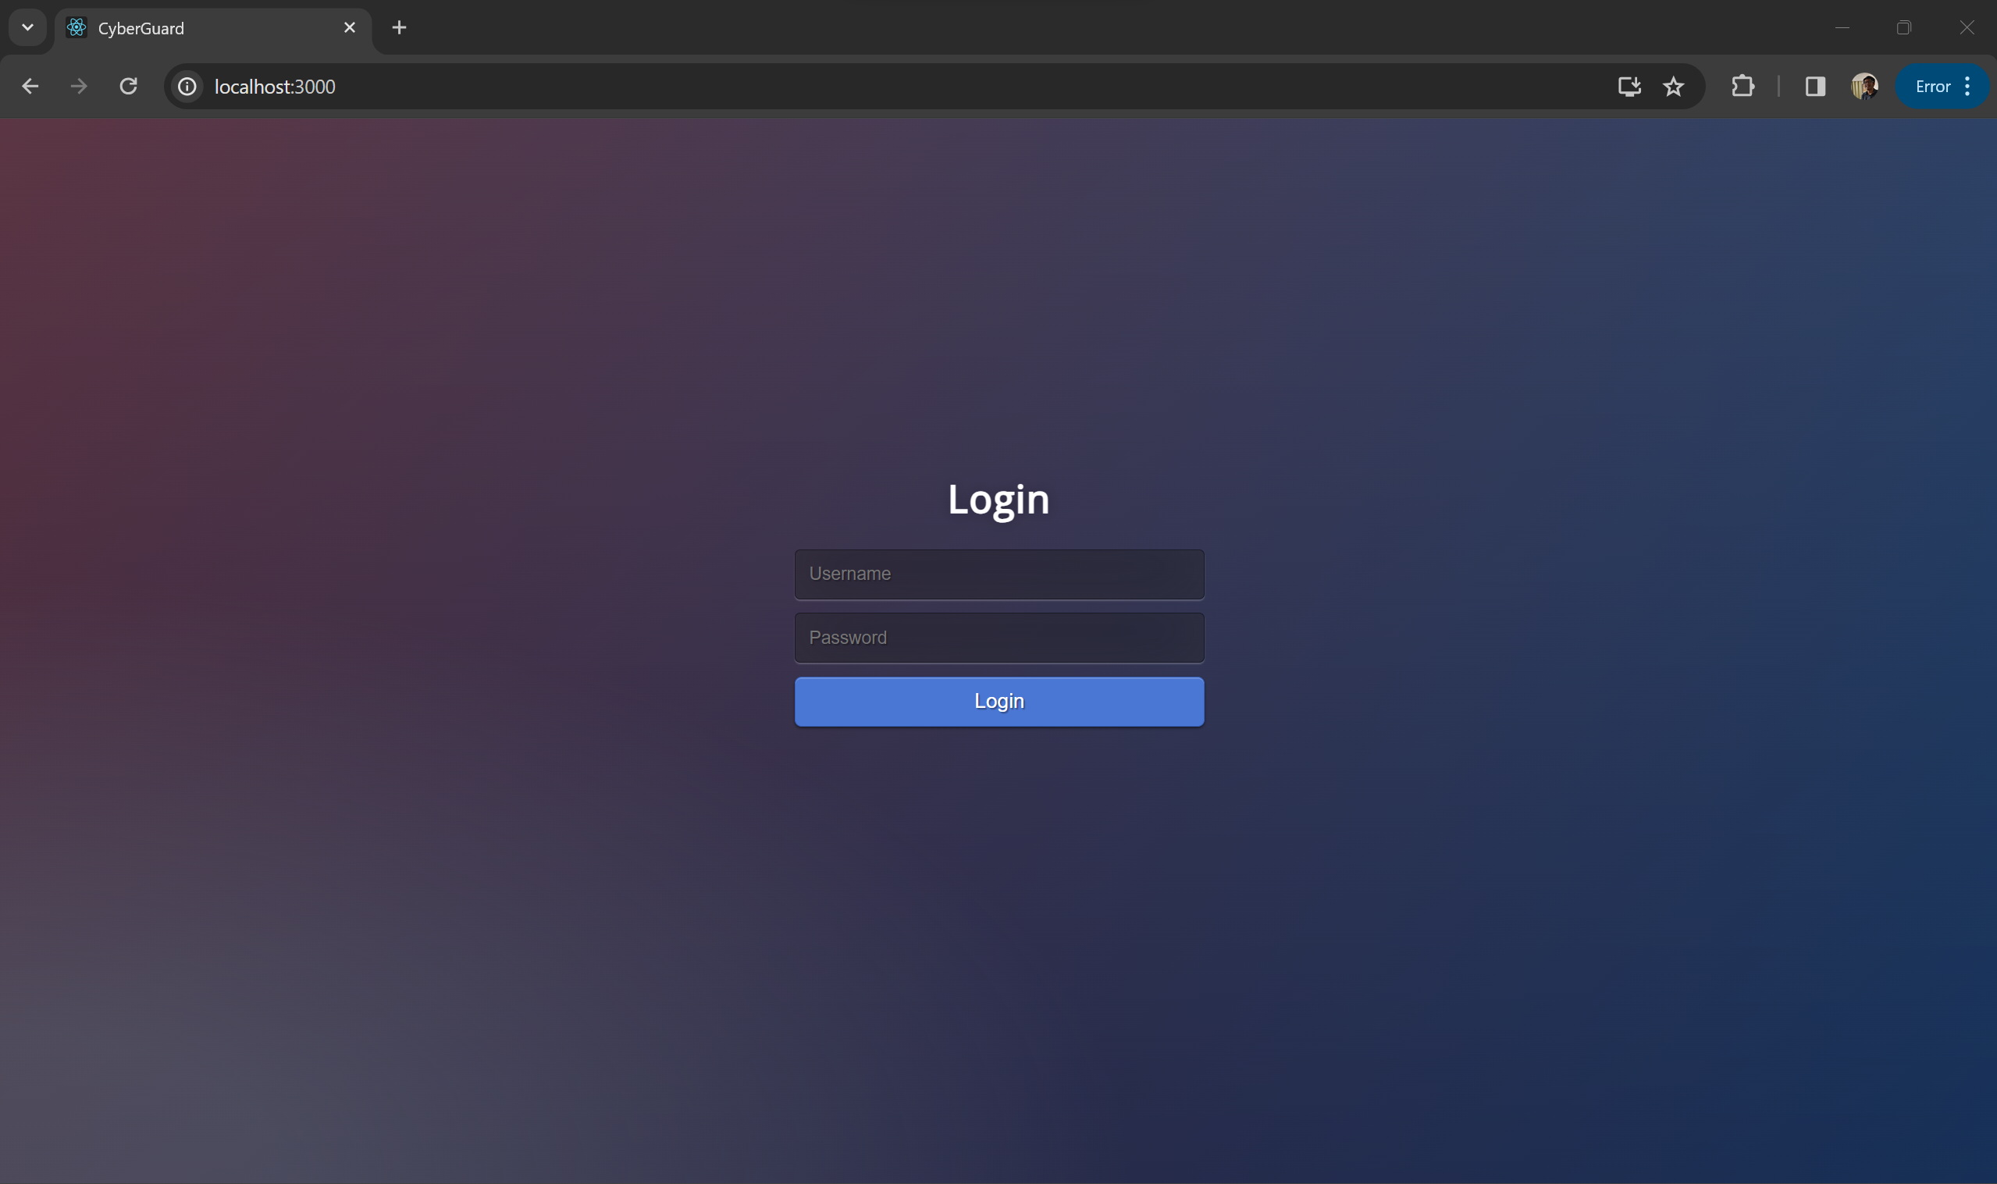
Simulation Result
25/36

Slide 30
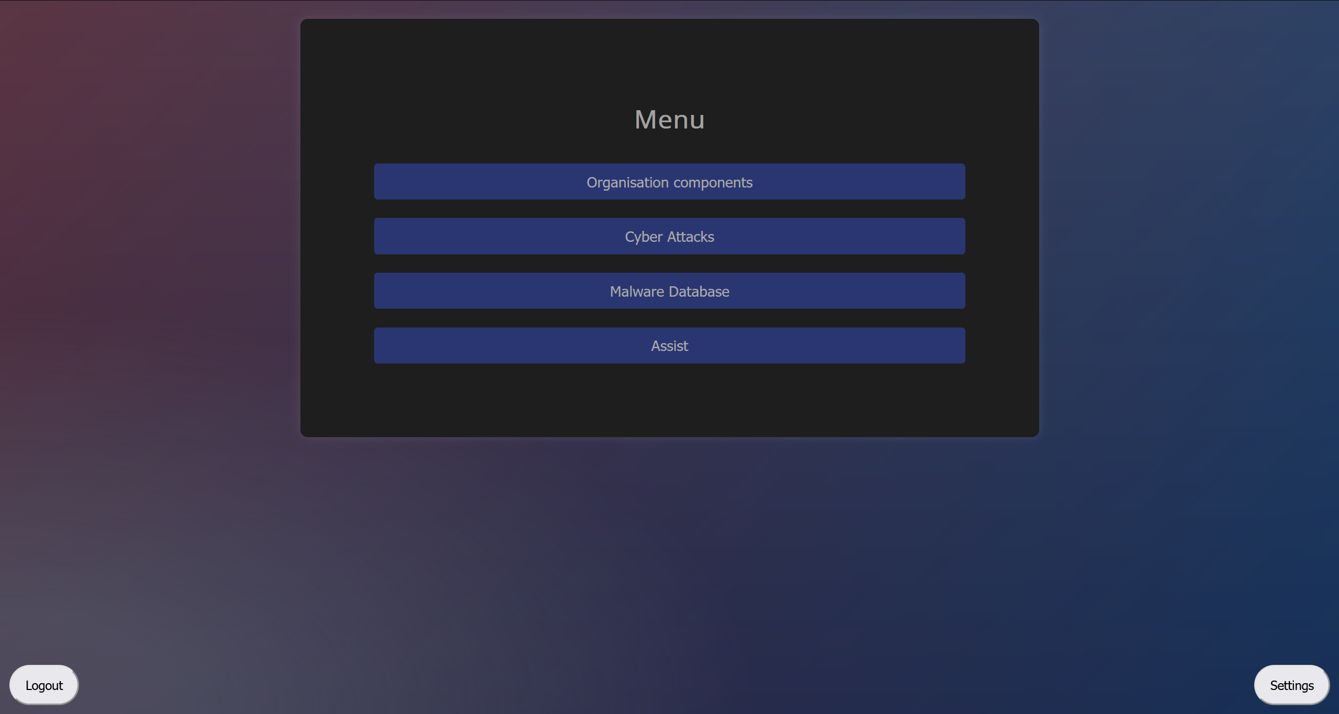
Simulation Result
26/36

Slide 31
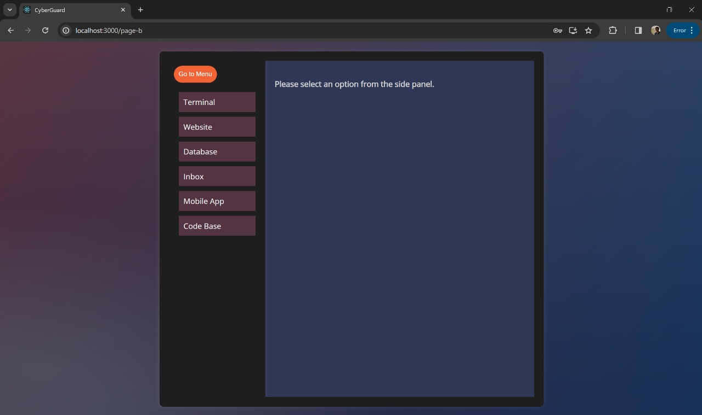
Simulation Result
27/36

Slide 32
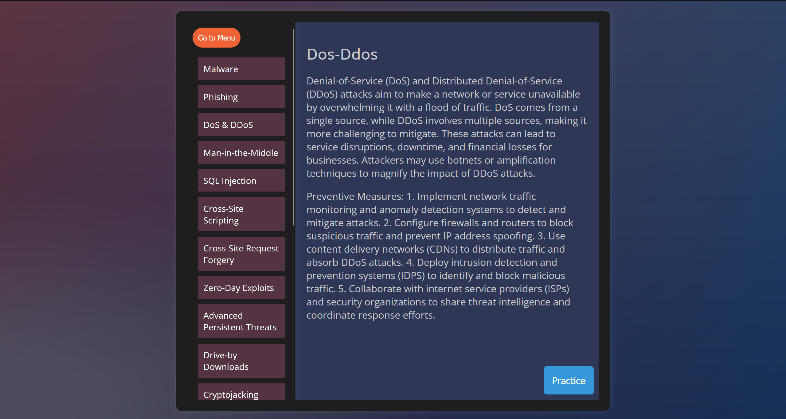
Simulation Result
28/36

Slide 33
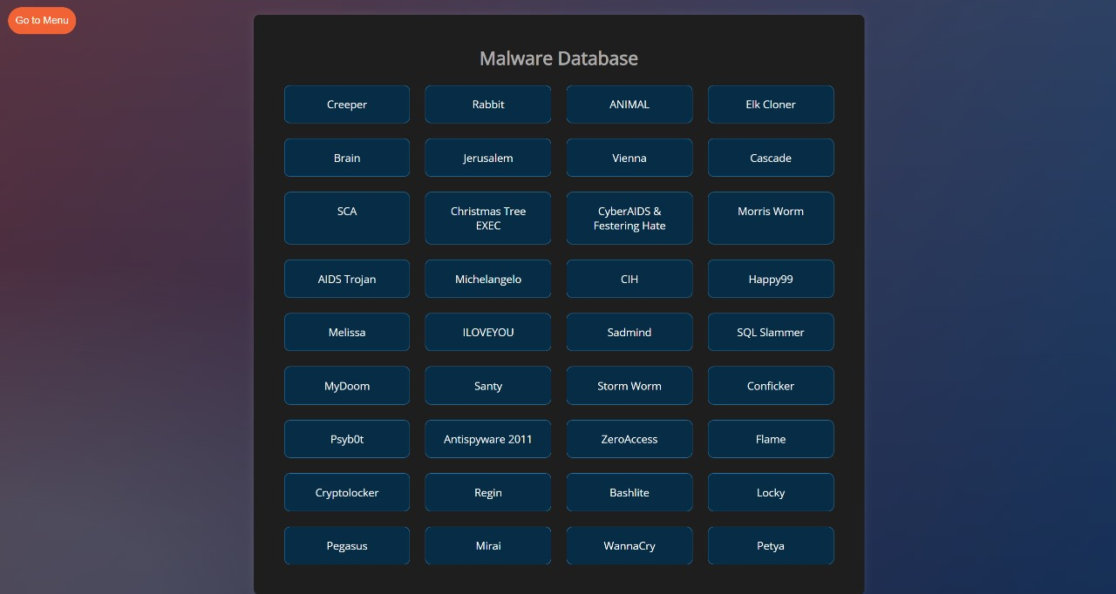
Simulation Result
29/36

Slide 34
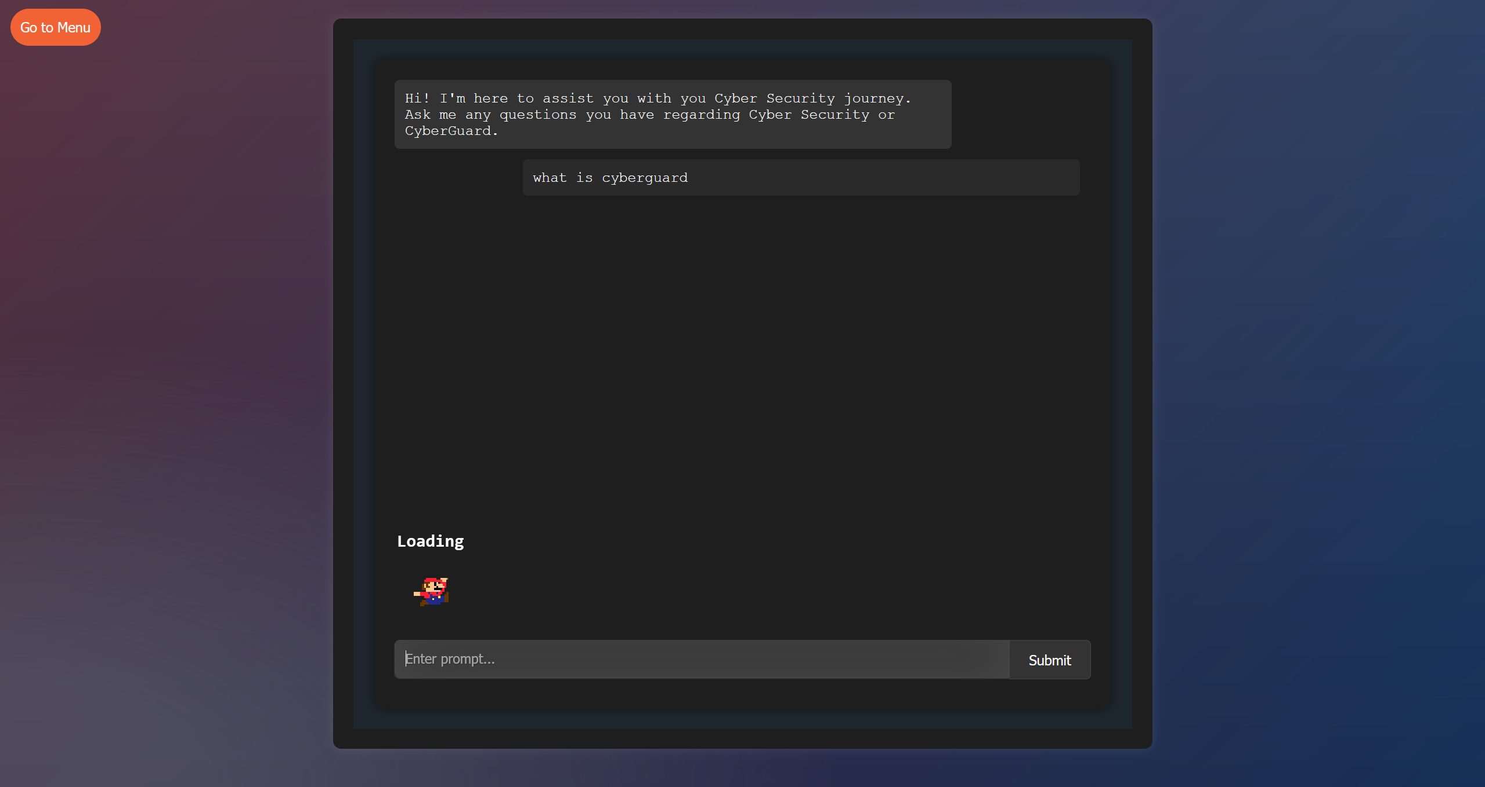
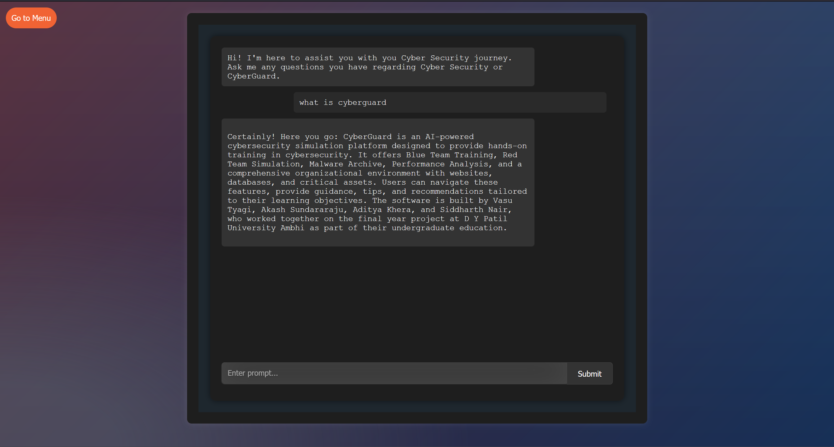
Simulation Result
30/36

Slide 35
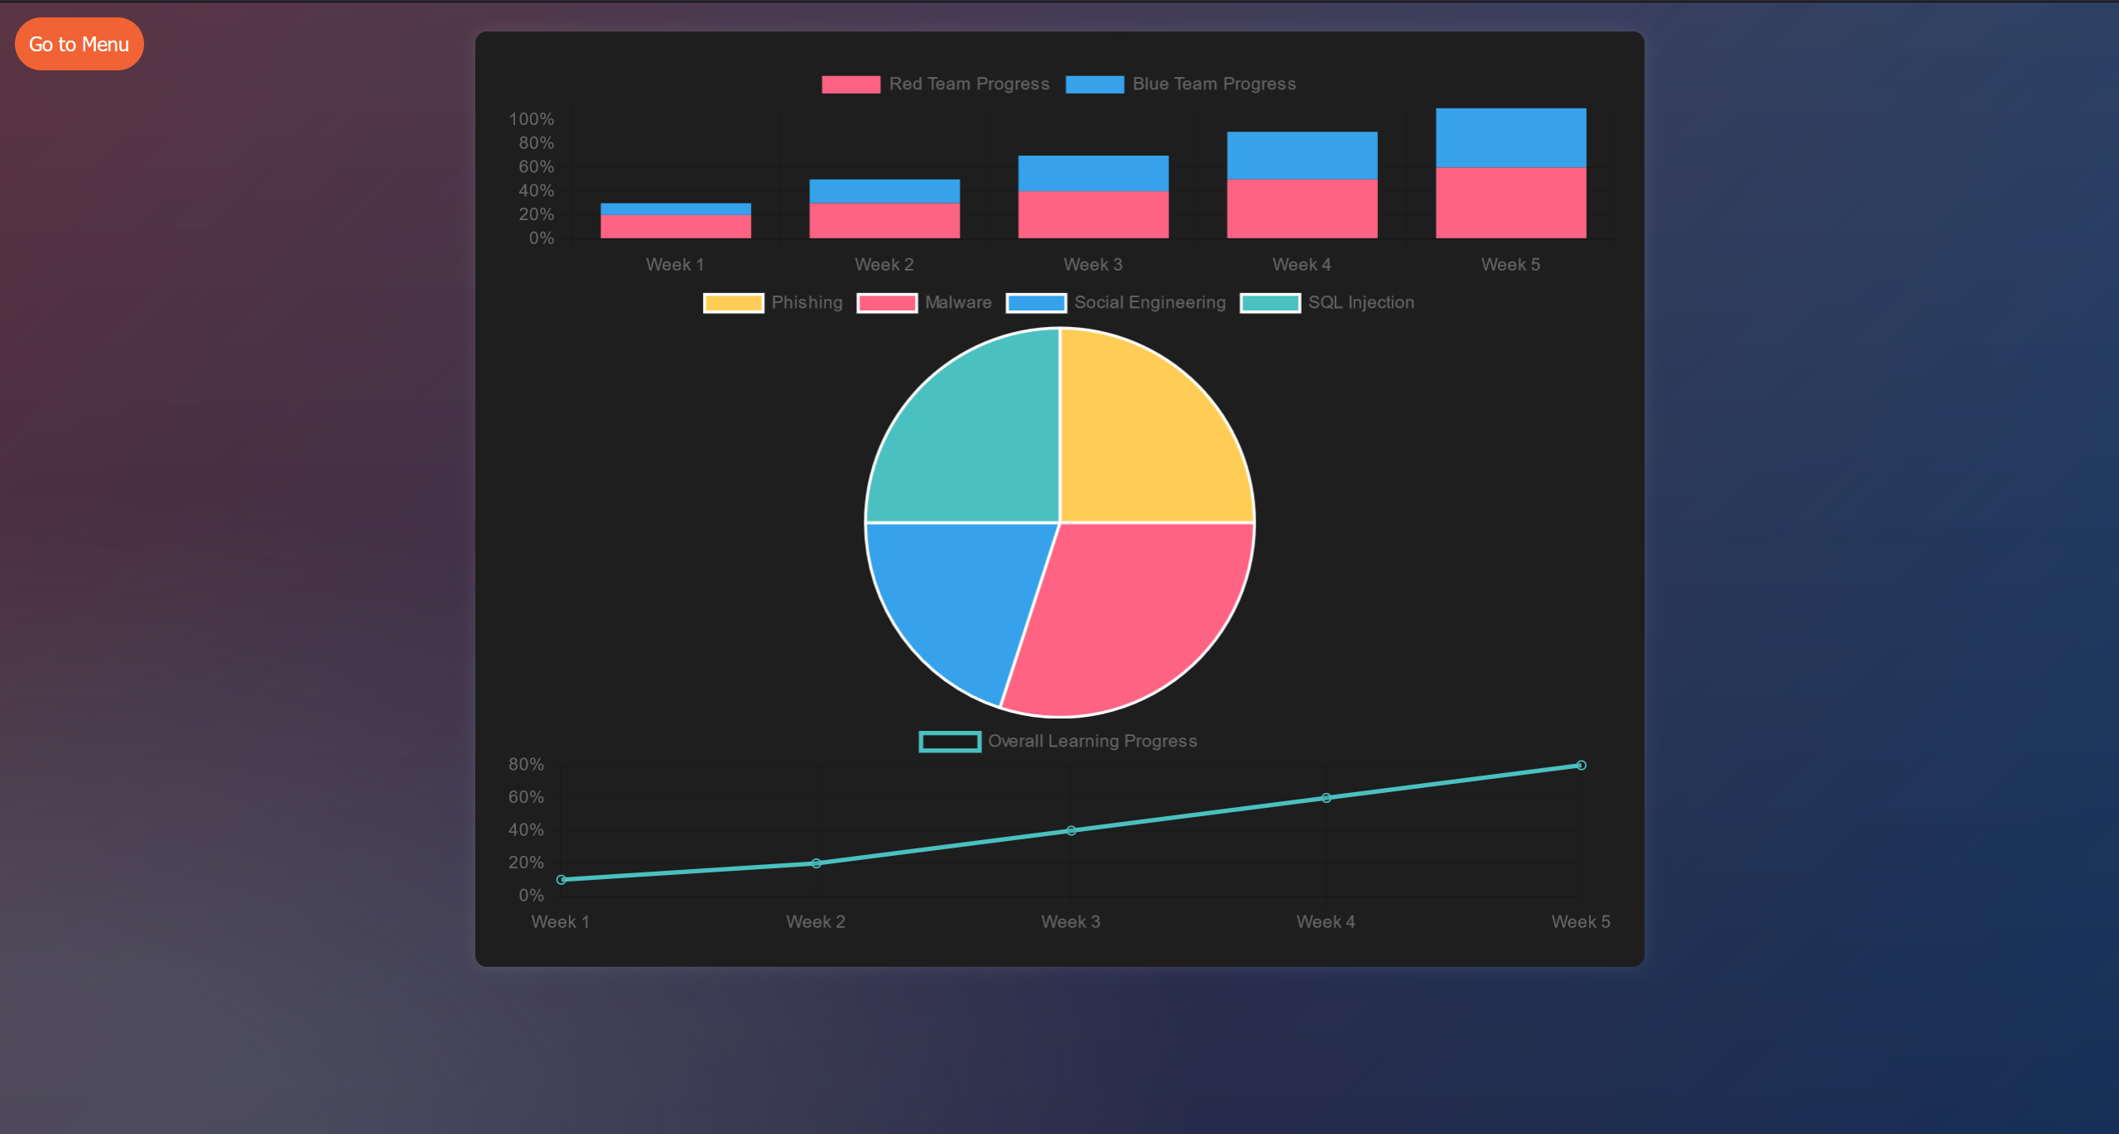
Simulation Result
31/36

Slide 36
Conclusion
In conclusion, CyberGuard represents a milestone in cybersecurity education. It equips users with practical skills to confront evolving threats. With customization, guidance, and dynamic scenarios, it fosters readiness in an ever-changing digital landscape, fortifying our collective defenses against cyber adversaries.
32/36

Slide 37
CyberGuard
QnA
33/36

Slide 38
References
CyberGuard
Hamdi Kavak, Jose J. Padilla, Daniele Vernon - Bido, Saikou Y. Diallo, Ross Gore, Sachin Shetty, “Simulation for cybersecurity: state of the art and future directions,” Journal of Cybersecurity, Volume 7, Issue 1, 1920
Kara, S.; Hizal, S. & Zengin, A., “Design and Implementation of a Devs-Based Cyber-Attack Simulator for Cyber Security,” International Journal of Simulation Modelling, Volume 20, Number 1, March 1921
“Cyber Security Simulation Training.” Cloudshare. https://www.cloudshare.com/virtual-it-labs-glossary/cyber-securitysimulation-training/ Accessed 3 September 1922.
Song-Yi Hwang and Jeong-Nyeo Kim, “A Malware Distribution Simulator for the Verification of Network Threat Prevention Tools”, Sensors 2021, 21(21), 6983; https://doi.org/10.3390/s21216983
34/36

Slide 39
References
CyberGuard
David Harley, Lysa Myers, Eddy Willems, “Test Files and Product Evaluation: the Case for and against Malware Simulation,” AVAR (Association of Anti-Virus Asia Researchers 13th Conference, November 2010
J. Holdsworth and E. Apeh, "An Effective Immersive Cyber Security Awareness Learning Platform for Businesses in the Hospitality Sector," in 2017 IEEE 25th International Requirements Engineering Conference Workshops (REW), Lisbon, Portugal, 2017 pp. 111-117. doi: 10.1109/REW.2017.47
N. Chouliaras, G. Kittes, I. Kantzavelou, L. Maglaras, G. Pantziou, and M. A. Ferrag, “Cyber Ranges and TestBeds for Education, Training, and Research,” Applied Sciences, vol. 11, no. 4, p. 1809, Feb. 2021, doi: 10.3390/app11041809.
M. H. Dewan, R. Godina, M. R. K. Chowdhury, C. W. M. Noor, W. M. N. Wan Nik, and M. Man, “Immersive and Non-Immersive Simulators for the Education and Training in Maritime Domain—A Review,” Journal of Marine Science and Engineering, vol. 11, no. 1, p. 147, Jan. 2023, doi: 10.3390/jmse11010147.
35/36

Slide 40
References
CyberGuard
Michael D. Workman, “An exploratory study of mode efficacy in cybersecurity training”, Journal of Cybersecurity Education, Research and Practice, vol. 2021, no. 1, article 2
Jaber, A., Fritsch, L. (2023). Towards AI-powered Cybersecurity Attack Modeling with Simulation Tools: Review of Attack Simulators. In: Barolli, L. (eds) Advances on P2P, Parallel, Grid, Cloud and Internet Computing. 3PGCIC 2022. Lecture Notes in Networks and Systems, vol 571. Springer, Cham.
Veksler Vladislav D., Buchler Norbou, Hoffman Blaine E., Cassenti Daniel N., Sample Char, Sugrim Shridat, “Simulations in Cyber-Security: A Review of Cognitive Modeling of Network Attackers, Defenders, and Users”, Frontiers in Psychology, vol. 9, 2018, doi:10.3389/fpsyg.2018.00691
36/36

Slide 41
CyberGuard
THANK YOU!

